Slide 1
╔══════════════════════════════════════════════════════════════╗
║ 🌿 PLANT BIOCHEMISTRY FOR HORTICULTURE · HORT 202 ║
║ ═════════════════════════════════════════════════════ ║
║ ║
║ ⚡ MODULE 3: PLANT METABOLISM & ENERGY SYSTEMS ║
║ ║
║ Photosynthesis · Respiration · Transport ║
║ Nitrogen & Lipid Metabolism ║
║ ║
║ Dilla University · Department of Horticulture ║
║ [Instructor Name] · [SemesterII/Year2026] ║
╚══════════════════════════════════════════════════════════════╝

Slide 2
MODULE II: OVERVIEW
📍 Section 2.1: Photosynthesis
• Light reactions & Calvin cycle
• C3, C4, and CAM plants
📍 Section 2.2: Respiration
• Glycolysis, Krebs cycle, ETC
• ATP accounting
📍 Section 2.3: Carbohydrate Transport
• Phloem structure & function
• Source-sink relationships
📍 Section 2.4: Nitrogen & Lipid Metabolism
• N assimilation & fixation
• Fatty acid synthesis

Slide 3
╔══════════════════════════════════════════════════════
║ LEARNING OBJECTIVES
║ ════════════════════════════════════════════
║ By the end of this module, you will be able to:
║
║ ✅ Explain how plants capture light energy to produce; ATP and NADPH
║
║ ✅ Describe the Calvin cycle and carbon fixation
║
║ ✅ Compare C3, C4, and CAM photosynthetic pathways
║
║ ✅ Calculate ATP yield from glucose through respiration
║
║ ✅ Understand how sugars are transported in plants
║
║ ✅ Explain nitrogen assimilation and biological fixation
║
║ ✅ Describe fatty acid and triglyceride synthesis
╚═══════════════════════════════════════════════════════

Slide 4
Overview: Plant Metabolism & Energy Systems
What is Metabolism?
The sum of all chemical reactions occurring in a living plant to maintain life.
It's a continuous balancing act between building up and breaking down.
The Two Sides of Metabolism:
🔋 Catabolism (Breaking Down):
Releases energy.
Example: Respiration (breaking glucose into CO₂ + H₂O to make ATP).
⛓️ Anabolism (Building Up):
Requires energy.
Example: Photosynthesis (building glucose from CO₂ + H₂O), protein synthesis, starch formation.
The Central Energy Currency: ATP
Adenosine Triphosphate is the universal energy carrier.
Energy released from catabolism (respiration) is used to make ATP.
ATP is then used to power anabolism and all cellular work (growth, transport, etc.).

Slide 5
Overview of Metabolic Pathways in Plants
The integrated network of thousands of chemical reactions that sustain life.
Converts energy from the sun into chemical energy (ATP) and building blocks for growth.
Unlike animals, plants are autotrophs—they must synthesize all their own organic molecules.

Slide 6
Overview of Metabolic Pathways in Plants The Three Functional Layers of Metabolism
Layer | Process | Input → Output | Energy | Key Examples
Layer 1: Energy Capture | Photosynthesis | Light + CO₂ + H₂O → Sugars (CH₂O) | Energy IN | Light reactions, Calvin cycle (C3/C4/CAM)
Layer 2: Energy Release | Respiration | Sugars (CH₂O) + O₂ → ATP + CO₂ + H₂O | Energy OUT | Glycolysis, Krebs cycle, ETC
Layer 3: Biosynthesis | Assimilation | Sugars + N/S/P → Proteins, Oils, Starch, DNA | Energy USED | N-assimilation, lipid synthesis, secondary metabolism

Slide 7
Overview of Metabolic Pathways in Plants Key Interconnections for Horticulture:
Connection | Pathway 1 | Pathway 2 | Horticultural Significance
Source-Sink | Photosynthesis (source leaves) | Translocation (phloem) | Determines yield potential
Sugar-Acid Balance | Gluconeogenesis | Organic acid metabolism | Fruit taste (Brix/acids)
Oil Synthesis | Photosynthesis (sugars) | Fatty acid biosynthesis | Oil quality in seeds
Nitrogen Integration | Respiration (carbon skeletons) | GS-GOGAT pathway | Protein content, fertilizer efficiency
Stress Response | Photosynthesis (damaged) | Antioxidant metabolism | Chilling injury, drought tolerance

Slide 8
Overview of Metabolic Pathways in Plants Why This Matters for Horticulturists:
Yield: The balance between photosynthesis (making) and respiration (using) determines harvestable biomass .
Quality: Secondary metabolites (pigments, flavors, aromas) are built from primary metabolic intermediates .
Storage Life: Post-harvest metabolism (respiration, gluconeogenesis from acids) determines shelf life .
Stress Tolerance: Metabolic flexibility allows plants to survive drought, temperature extremes, and poor soils .

Slide 9
Overview of Metabolic Pathways in Plants The Central Hub: Carbon Metabolism
All pathways connect through common intermediates.
Glucose-6-P can go to: glycolysis (energy), starch (storage), or pentose phosphate pathway (building blocks).
Pyruvate can go to: Krebs cycle (energy), gluconeogenesis (sugar), or fatty acids (oils).

Slide 10
Module II Roadmap: Where We're Going
Section | Focus | Key Question
1. Photosynthesis | Capturing light, fixing CO₂ | How do plants build sugars?
2. Respiration | Breaking down sugars for energy | How do plants use those sugars?
3. Translocation | Moving sugars and assimilates | How do sugars get to fruits/roots?
4. Assimilation | Building oils, proteins, waxes | How do plants store and protect?
5. Applied Metabolism | Quality, stress, post-harvest | How does this affect my crop?

Slide 11
🍃 SECTION 2.1: PHOTOSYNTHESIS

Slide 12

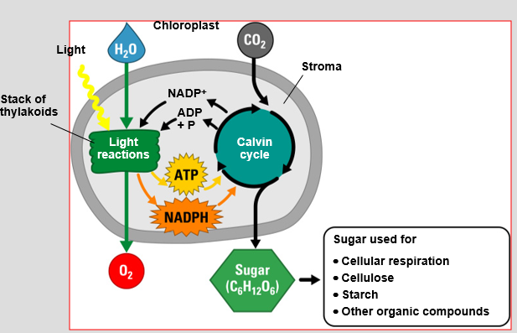
Photosynthesis Overview
Two Stages:
☀️ LIGHT REACTIONS
• Occur in thylakoid membranes
• Convert light energy → ATP + NADPH
• Produce O₂ from water splitting
🌱 CALVIN CYCLE (Light-independent)
• Occur in stroma
• Use ATP + NADPH to fix CO₂ → sugars
KEY CONCEPT: Light reactions produce the energy (ATP) and reducing power (NADPH) for the Calvin cycle

Slide 13
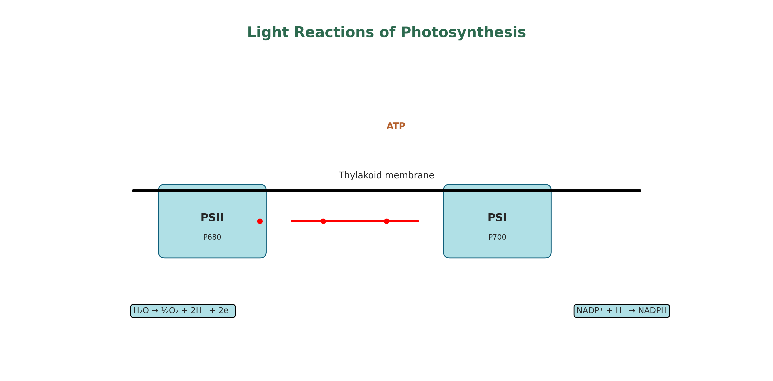
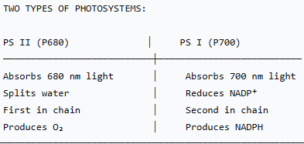
Light Reactions - Photosystems
ANTENNA COMPLEX
• Hundreds of pigment molecules • Chlorophyll a, b, carotenoids • Capture light energy • Transfer energy to reaction center
REACTION CENTER
• Special pair of chlorophyll molecules
• Where energy conversion happens
• Ejects high-energy electrons

Slide 14
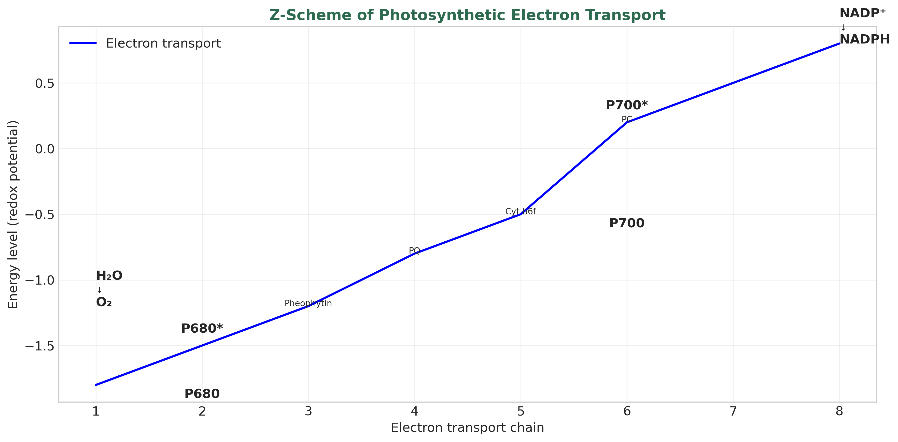
Light Reactions - Electron Flow (Z-scheme)
SEQUENCE OF EVENTS:
1. Light excites PSII → P680* ejects e⁻
2. Electrons move through chain:
P680 → Pheophytin → Plastoquinone (PQ)
→ Cytochrome b₆f → Plastocyanin (PC)
3. Protons (H⁺) pumped into thylakoid lumen
4. Light excites PSI → P700* ejects e⁻
5. Electrons reduce NADP⁺ → NADPH 6. Water splitting replaces electrons in PSII:
2H₂O → O₂ + 4H⁺ + 4e⁻

Slide 15
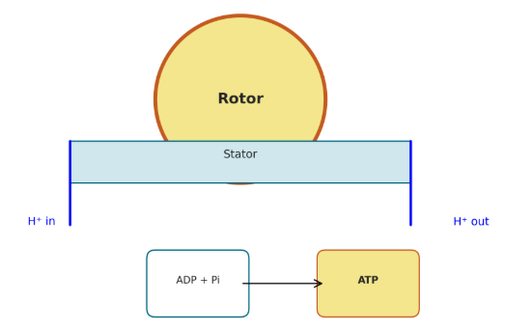
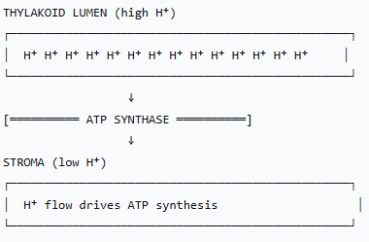
ATP Synthesis - Chemiosmosis
HOW IT WORKS:
Electron transport pumps H⁺ into thylakoid lumen
Creates proton gradient (chemical + electrical)
H⁺ flow back through ATP synthase
ATP synthase rotates, phosphorylating ADP → ATP
ATP Synthase = Molecular turbine!
📌 Photophosphorylation: Light-driven ATP synthesis

Slide 16
PRODUCTS OF LIGHT REACTIONS
ATP ────→ Energy for Calvin cycle
NADPH ──→ Reducing power for Calvin cycle
O₂ ─────→ Byproduct released to atmosphere
ENERGY ACCOUNTING (per 4 e⁻ from water):
Non-cyclic photophosphorylation:
Cyclic photophosphorylation (PSI only):
Electrons cycle around PSI
Produces: ATP only (no NADPH, no O₂)
Used when cell needs extra ATP
2 H₂O → O₂ + 4H⁺ + 4e⁻
4e⁻ flow through PSII and PSI
Produces: ~1 NADPH + ~1.5 ATP per e⁻ pair

Slide 17
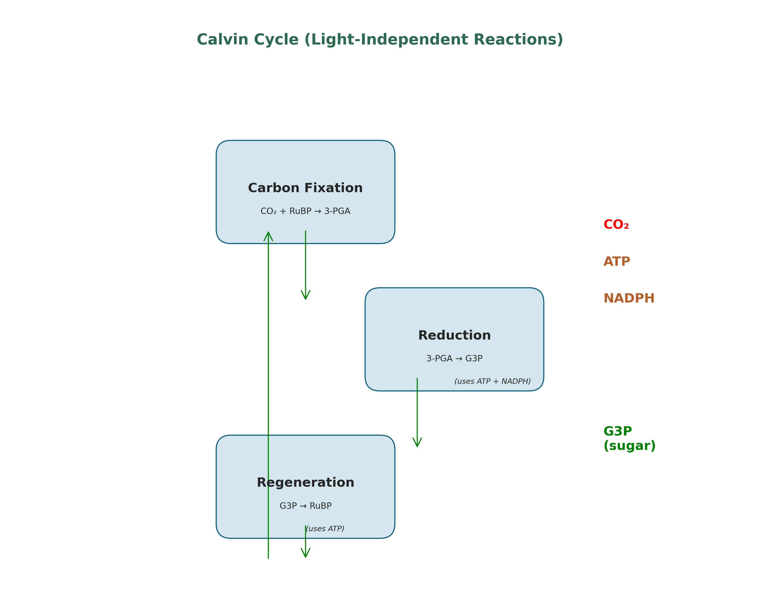
The Calvin Cycle - Overview
PHASE 1: CARBON FIXATION
RuBP (5C) + CO₂ → 2 × 3-PGA (3C)
Enzyme: Rubisco
PHASE 2: REDUCTION 3-PGA → G3P (glyceraldehyde-3-phosphate)
Uses: ATP + NADPH from light reactions
PHASE 3: REGENERATION
G3P → RuBP
Uses: ATP
📌 To produce 1 G3P (3C sugar):
3 CO₂ + 9 ATP + 6 NADPH

Slide 18
RUBISCO: EARTH'S MOST ABUNDANT PROTEIN
Ribulose bisphosphate carboxylase/oxygenase
STRUCTURE: • 16 subunits (8 large + 8 small) • Large subunit = catalytic
Small subunit = regulatory
Up to 50% of soluble leaf protein!
THE PROBLEM: Rubisco can't distinguish CO₂ from O₂ well!
CARBOXYLATION (good):
RuBP + CO₂ → 2 × 3-PGA
OXYGENATION (bad - photorespiration):
RuBP + O₂ → Phosphoglycolate + 3-PGA
Wastes energy
Releases CO₂
Increases at high temperatures
WHY SO SLOW? ║
║ • Only 3 reactions/second ║
║ • Plants compensate by making massive amounts!

Slide 19
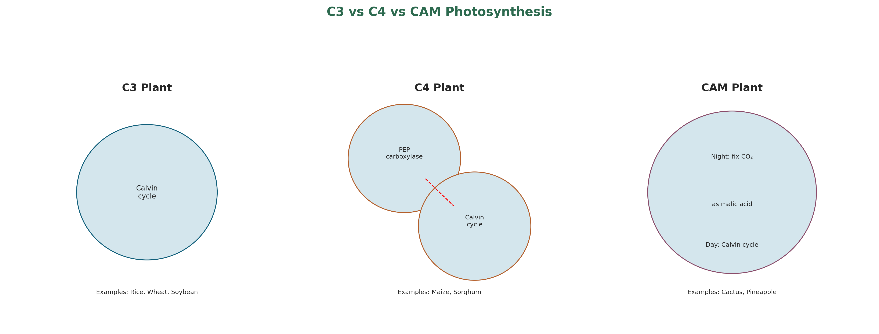

Slide 20
C3 vs C4 vs CAM PHOTOSYNTHESIS
C3 PLANTS
C4 PLANTS
First product: 3-PGA (3C)
Direct Calvin cycle in mesophyll
Examples: Rice, Wheat, Soybean, Potato
Photorespiration: High
Water use efficiency: Low
First product: Oxaloacetate (4C)
Kranz anatomy (two cell types)
CO₂ concentrated in bundle sheath
Examples: Maize, Sugarcane, Sorghum
Photorespiration: Low
Water use efficiency: High
CAM PLANTS
║ ║ • Fix CO₂ at night (stomata open) ║ ║
║ ║ • Store as malic acid in vacuoles ║ ║
║ ║ • Use CO₂ during day (stomata closed) ║
║ ║ • Examples: Cactus, Pineapple, Succulents
║ ║ • Photorespiration: Very low ║ ║
║ ║ • Water use efficiency: Extremely high

Slide 21
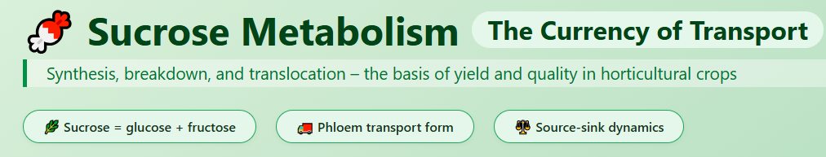

Slide 22
Sucrose Metabolism
primary form in which carbon is transported from photosynthetic source tissues (leaves) to heterotrophic sink tissues (roots, fruits, seeds, tubers).
a major storage compound in many crops (sugarcane, sugar beet, sweet sorghum)
a key determinant of fruit sweetness and quality .

Slide 23
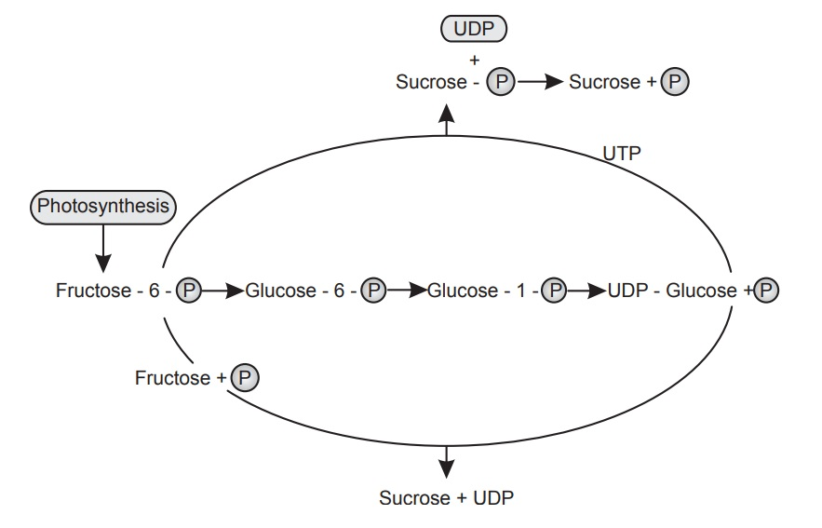
Sucrose biosynthesis in source leaves
Triose phosphates (from Calvin cycle) exported from chloroplast via phosphate translocator.
Fructose-1,6-bisphosphate → fructose-6-phosphate (FBPase).
Glucose-1-phosphate + UTP → UDP-glucose (UDP-glucose pyrophosphorylase).
Sucrose phosphate synthase (SPS) – combines UDP-glucose + fructose-6-phosphate → sucrose-6-phosphate.
Sucrose phosphate phosphatase (SPP) – removes phosphate → sucrose.

Slide 24
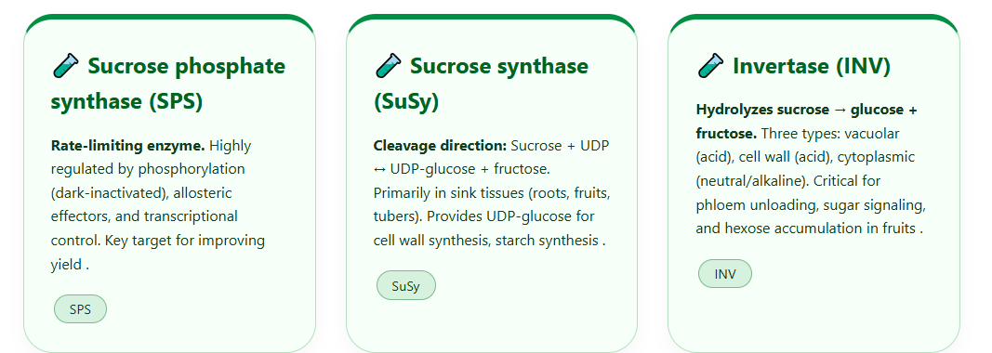

Slide 25
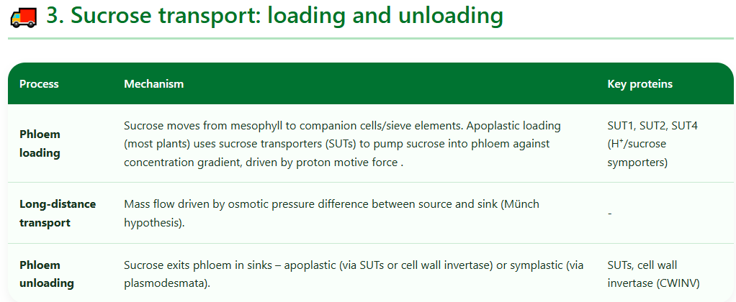

Slide 26
Source-sink dynamics
Yield is determined by:
Source strength = photosynthetic rate × source size (leaf area).
Sink strength = sink size × sink activity (capacity to import and metabolize sucrose).
Sinks can feedback-regulate sources via sugar signaling (e.g., high sucrose downregulates photosynthesis genes) .

Slide 27
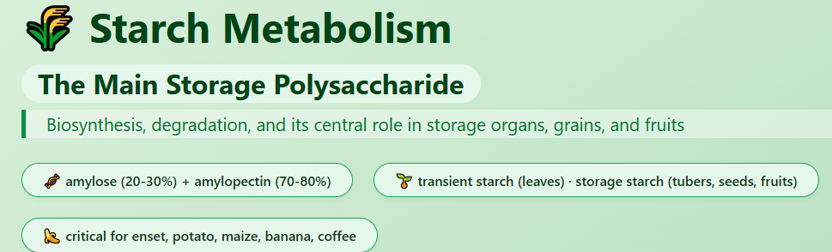

Slide 28
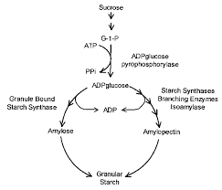
Starch biosynthesis
Starch is synthesized in chloroplasts (transient starch) and amyloplasts (storage starch).
ADP-glucose pyrophosphorylase (AGPase) – Glucose-1-phosphate + ATP → ADP-glucose + PPi. Rate-limiting, allosterically activated by 3-PGA, inhibited by Pi .
Starch synthases (SS) – elongate α-1,4 chains using ADP-glucose. Multiple isoforms (GBSS for amylose, SSI-IV for amylopectin).
Branching enzyme (BE) – creates α-1,6 branch points.
Debranching enzyme (DBE) – trims improperly branched chains, crucial for crystalline structure.

Slide 29
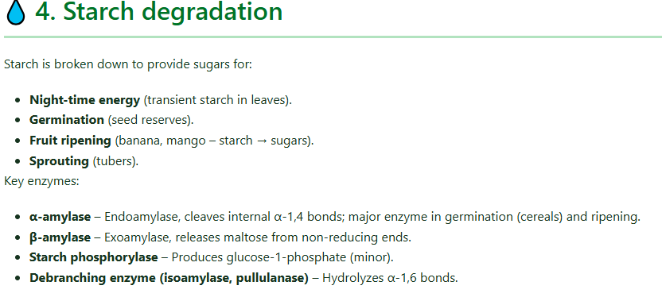

Slide 30
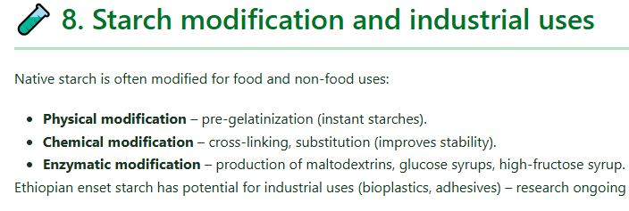

Slide 31
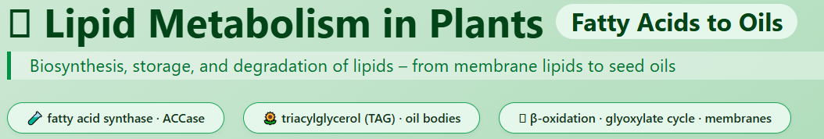

Slide 32
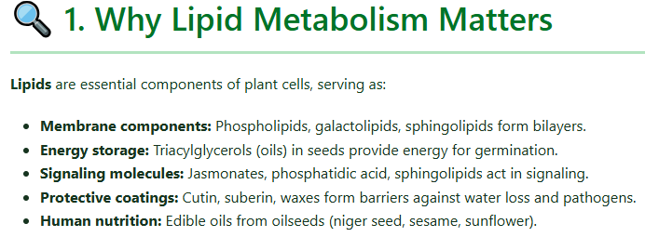

Slide 33
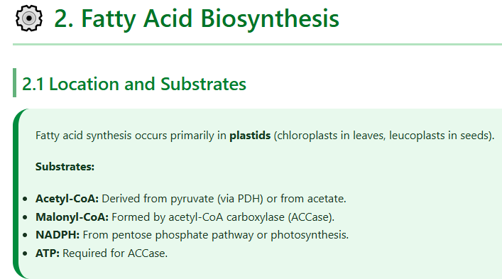

Slide 34
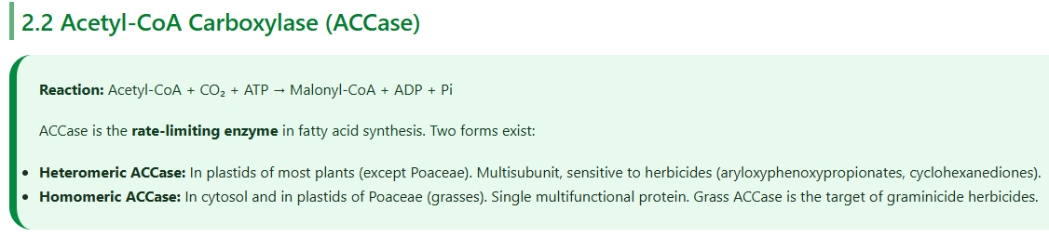

Slide 35
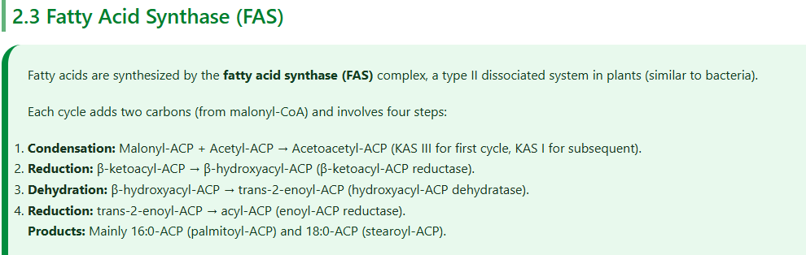

Slide 36
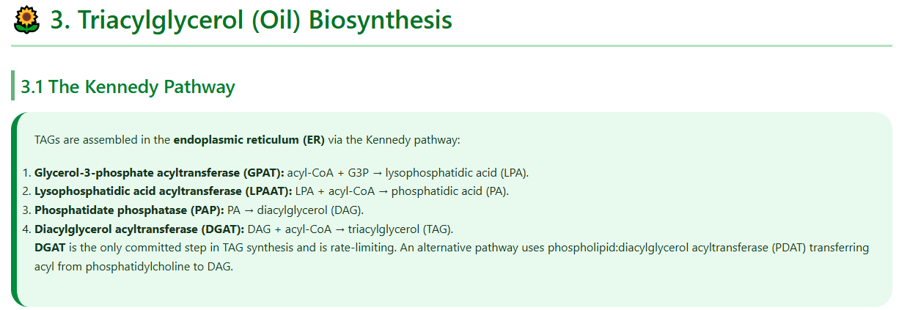

Slide 37
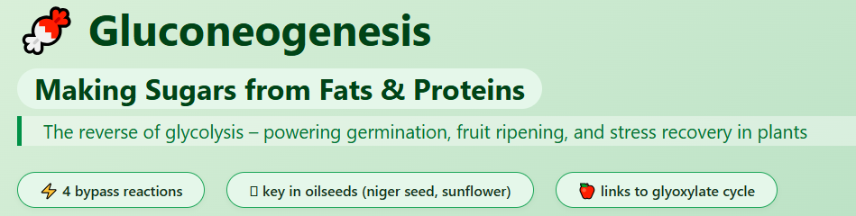

Slide 38
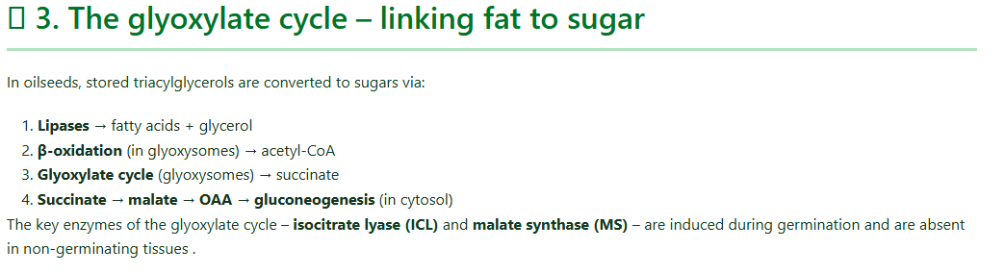

Slide 39
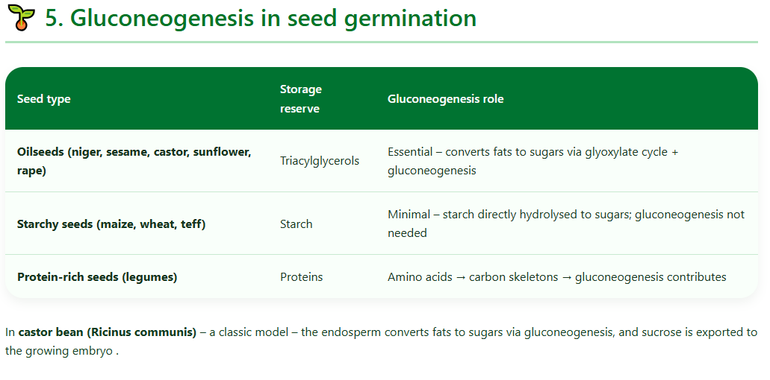

Slide 40
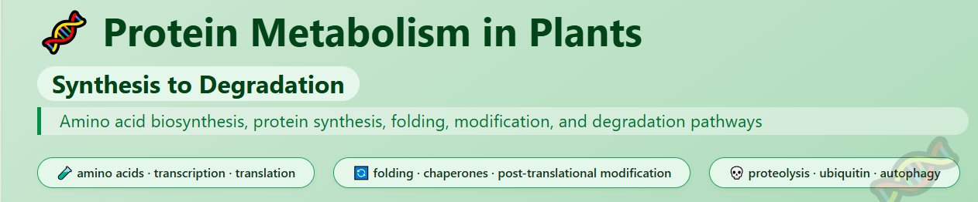

Slide 41
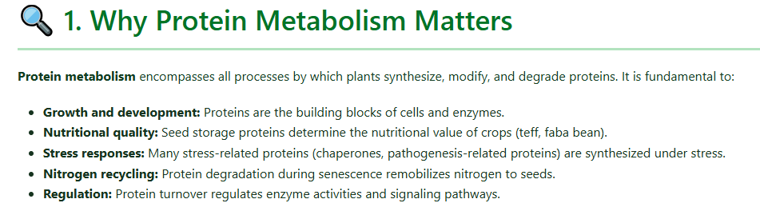

Slide 42

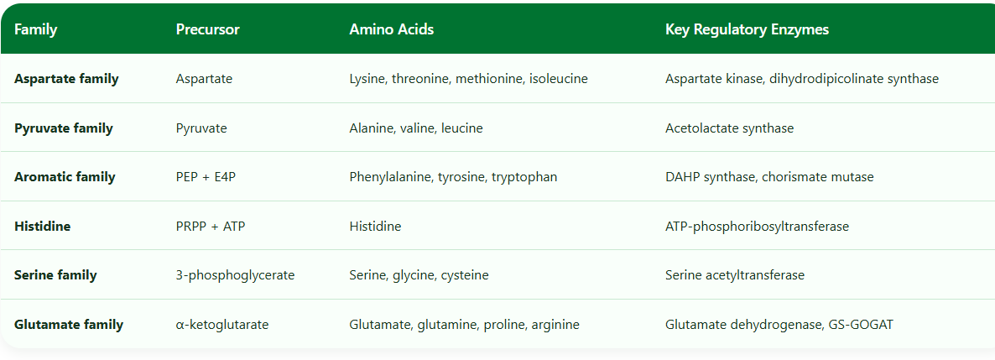
Amino acids are synthesized from intermediates of primary metabolism (glycolysis, TCA cycle, pentose phosphate pathway). They are grouped into families based on their precursor.

Slide 43
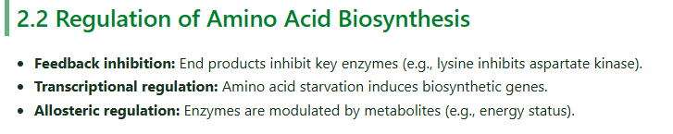

Slide 44
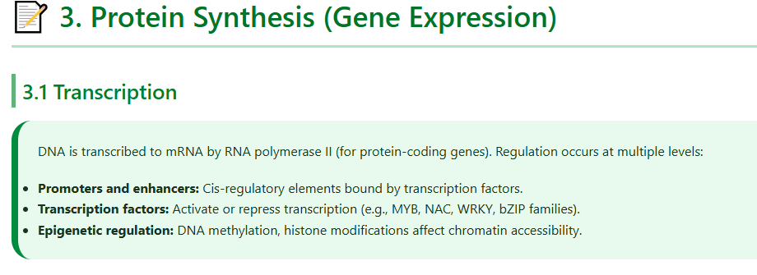

Slide 45
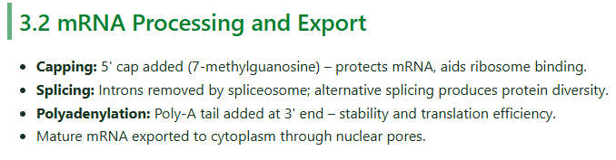

Slide 46
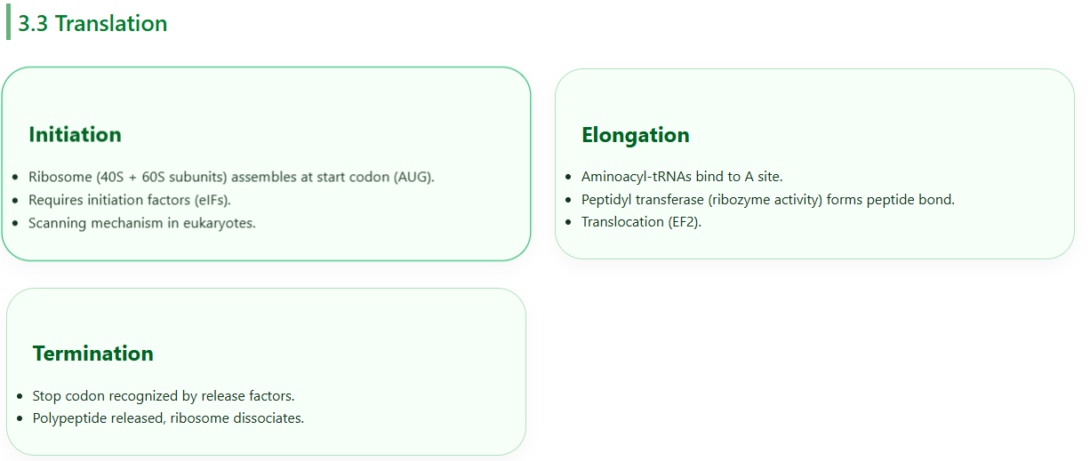

Slide 47
Kranz Anatomy (C4 Plants)
MESOPHYLL CELLS
Initial CO₂ fixation via PEP carboxylase
Produces 4C compound (oxaloacetate → malate)
High affinity for CO₂ (no photorespiration)
BUNDLE SHEATH CELLS (wrapped around veins)
Malate → CO₂ + pyruvate
CO₂ fixed by Rubisco in Calvin cycle
High CO₂ concentration suppresses photorespiration

Slide 48
SECTION 2.2: RESPIRATION

Slide 49

Cellular Respiration Overview
STAGE 1: GLYCOLYSIS
Location: Cytoplasm
Glucose → 2 Pyruvate + 2 ATP + 2 NADH
STAGE 2: KREBS CYCLE (Citric Acid Cycle)
Location: Mitochondrial matrix
Pyruvate → Acetyl-CoA → CO₂ + NADH + FADH₂ + ATP
STAGE 3: ELECTRON TRANSPORT CHAIN
& OXIDATIVE PHOSPHORYLATION
Location: Inner mitochondrial membrane
NADH/FADH₂ → ATP (most of the ATP!)
Glycolysis and Krebs produce only 4 ATP directly! ║
║ Most ATP comes from ETC!

Slide 50
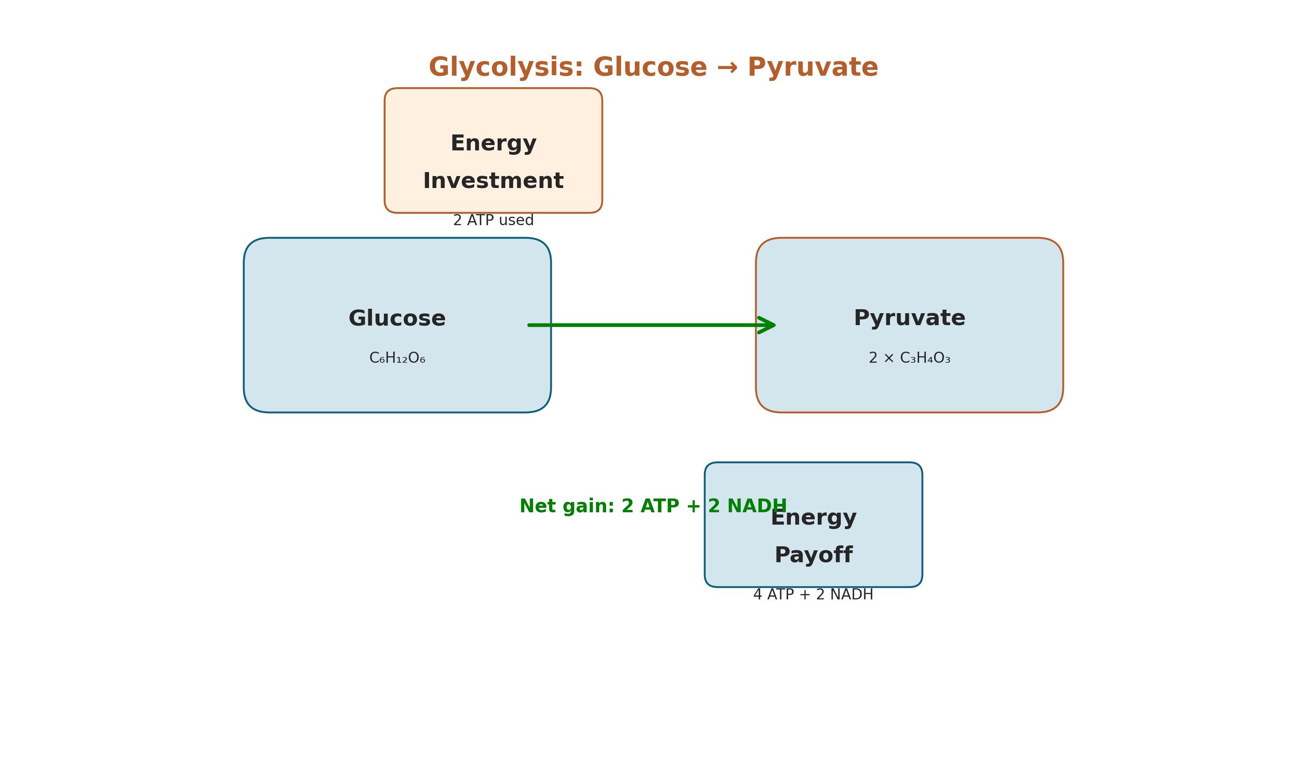
Glycolysis - BREAKING DOWN GLUCOSE
ENERGY INVESTMENT PHASE (uses ATP)
Glucose → Glucose-6-phosphate → Fructose-1,6-bisP
Uses: 2 ATP
SPLITTING
Fructose-1,6-bisP → 2 × G3P (glyceraldehyde-3-P)
ENERGY PAYOFF PHASE (produces ATP + NADH)
2 G3P → 2 Pyruvate
Produces: 4 ATP + 2 NADH
NET GAIN PER GLUCOSE: 2 ATP + 2 NADH + 2 Pyruvate
KEY REGULATORY ENZYME: Phosphofructokinase (PFK)

Slide 51
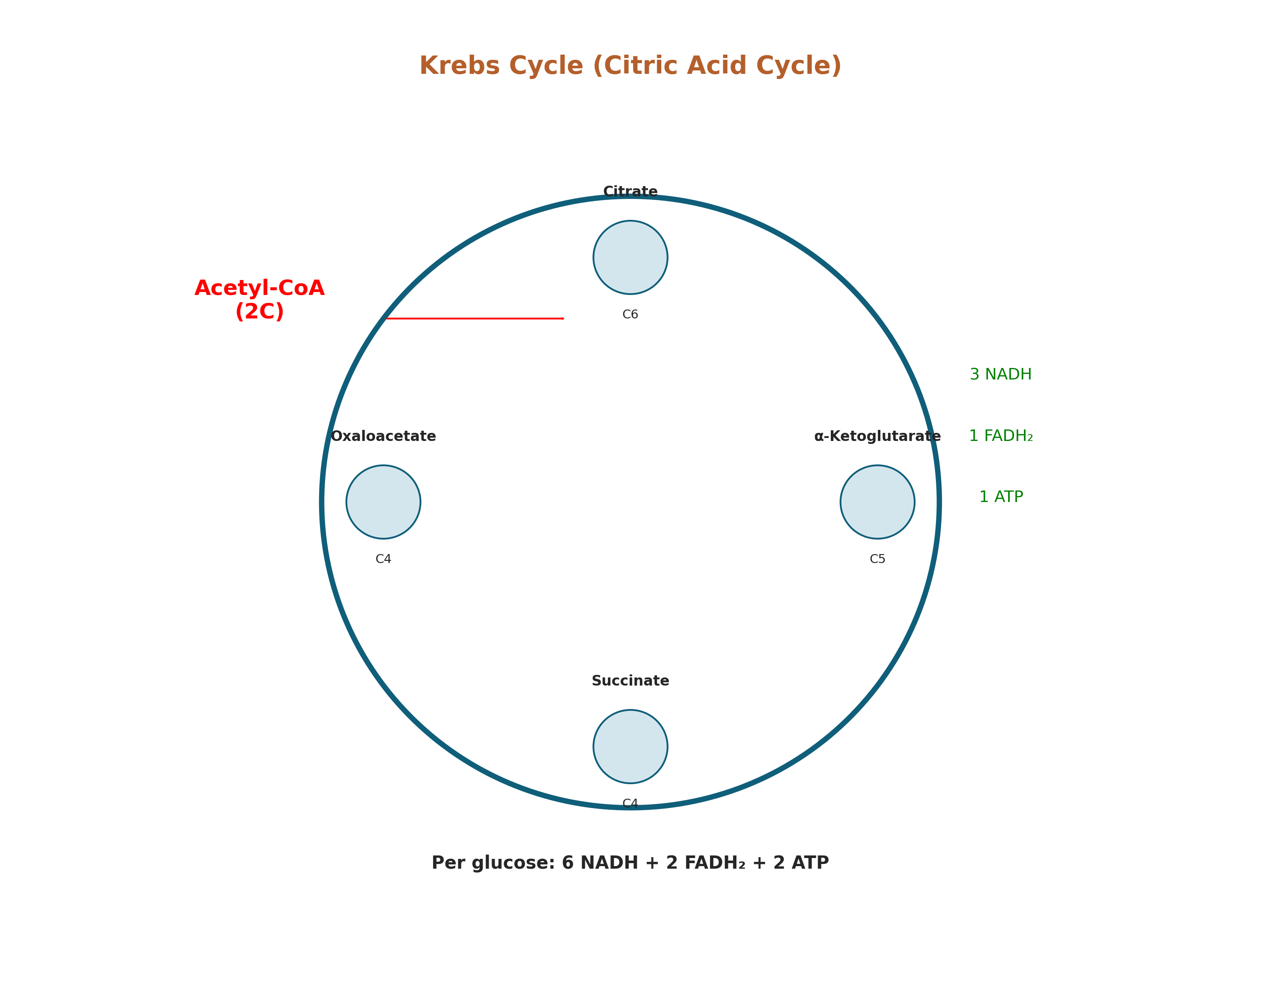
2.2.2 The Krebs Cycle (Completing Oxidation)
Location: Mitochondrial matrix.
Input: Acetyl-CoA (derived from pyruvate from glycolysis).
Process: A cyclical series of redox reactions that completes the oxidation of glucose.
Key Outputs (per glucose):
6 NADH (high-energy electrons)
2 FADH₂ (another electron carrier)
2 ATP (direct)
4 CO₂ (waste, but used in photosynthesis)
Significance: Extracts most of the remaining electrons from the original glucose molecule, preparing them for the final energy harvest.

Slide 52
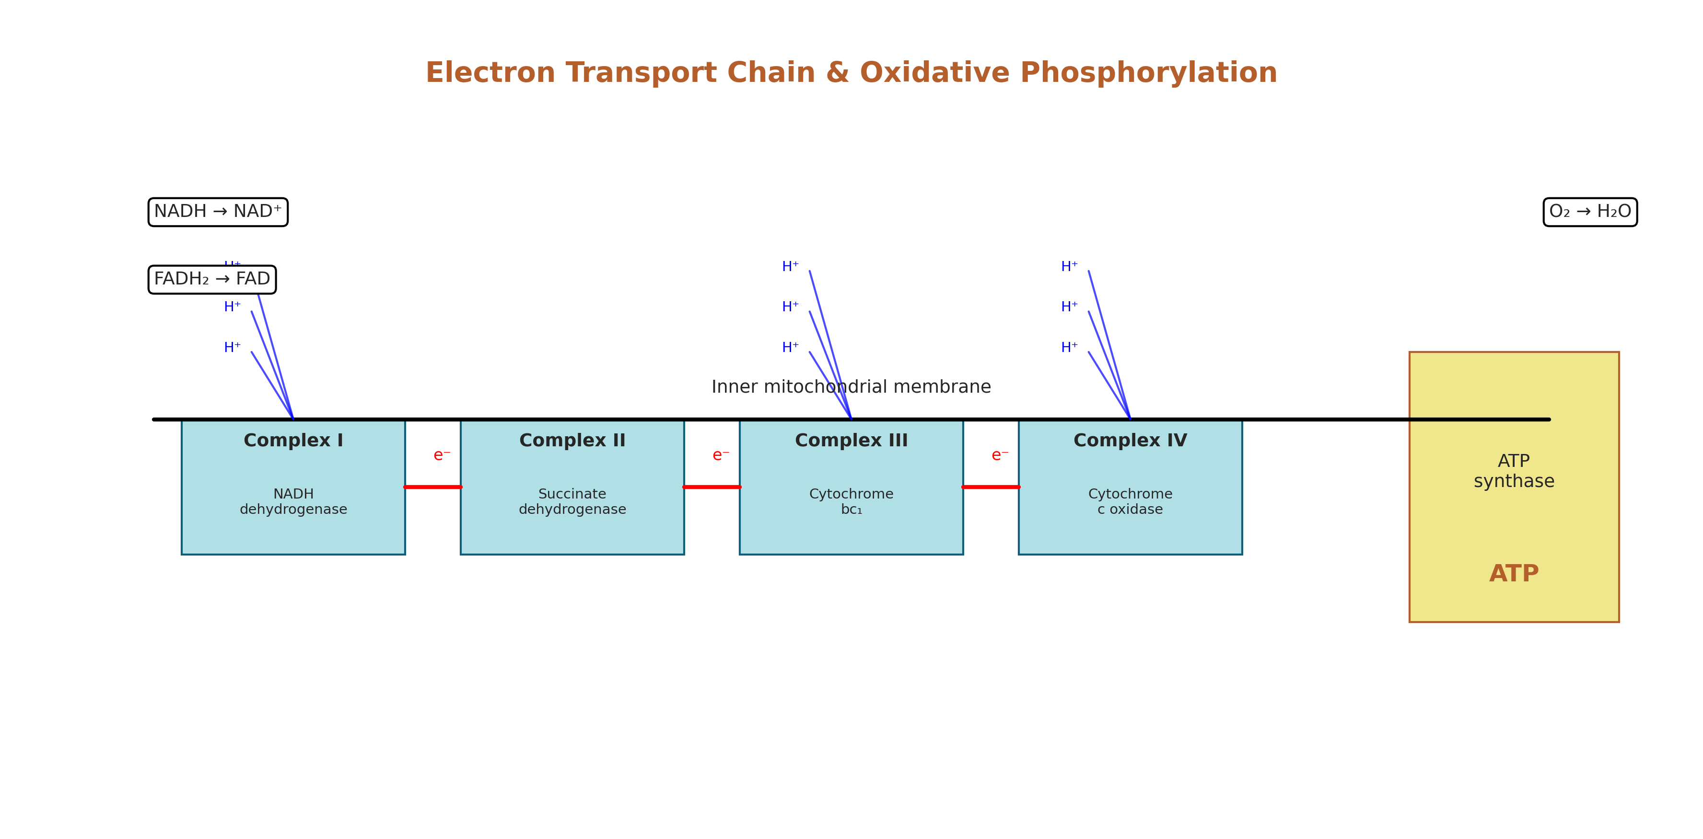
2.2.3 & 2.2.4 Electron Transport Chain (ETC) & Oxidative Phosphorylation
Location: Inner mitochondrial membrane.
The Process:
Electron Transport: NADH and FADH₂ from glycolysis and the Krebs cycle donate electrons to the ETC.
Proton Pumping: The energy from electrons pumps protons (H⁺) across the inner membrane, creating a gradient.
Chemiosmosis: Protons flow back down their gradient through the enzyme ATP synthase, driving the synthesis of a massive amount of ATP.
Final Output: ~32-34 ATP per glucose + H₂O.
Module Connection: This is oxidative phosphorylation—the cell's major energy payoff, using oxygen as the final electron acceptor.

Slide 53
2.2.5 & 2.2.6 Respiration in Horticulture: Storage Life & Chilling Injury
Storage Life: After harvest, crops continue to respire, breaking down stored reserves (starches, sugars). Faster respiration = shorter storage life.
Management: Cooling, controlled atmospheres (low O₂, high CO₂) slow respiration enzymes.
Chilling Injury: Tropical plants (e.g., tomato, banana) exposed to cold (<10-13°C) but non-freezing temperatures.
Mechanism: Membrane fluidity decreases, disrupting mitochondrial function (ETC). This leads to metabolic imbalances, build-up of toxic compounds (like acetaldehyde), and visible damage (pitting, poor ripening).

Slide 54
Section 3: Translocation & Partitioning

Slide 55
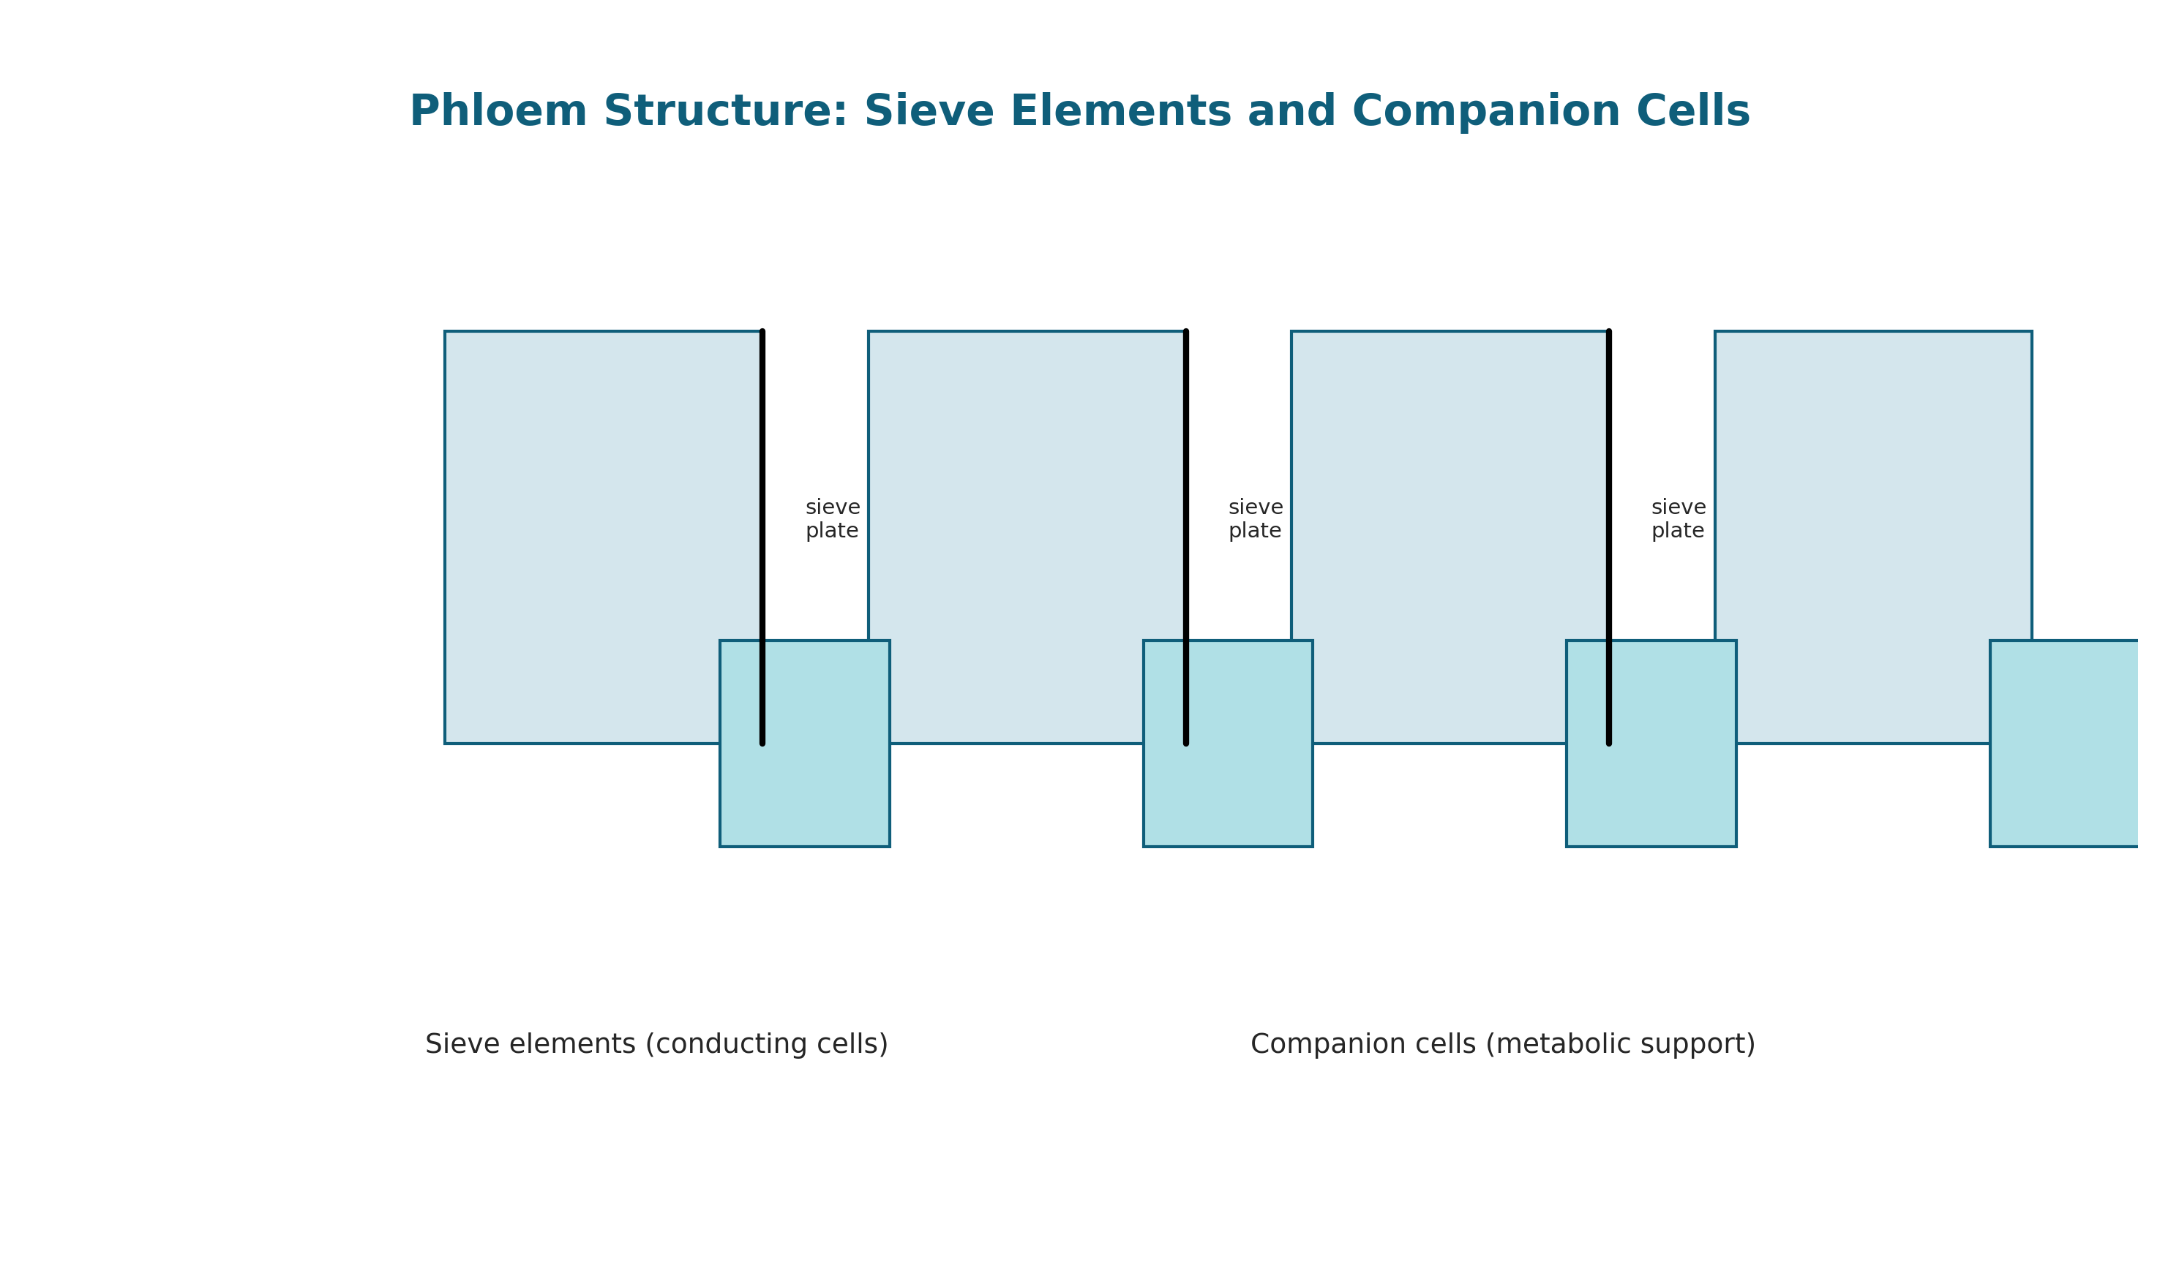
3.1 & 3.2 Phloem Structure: Sieve Elements & Companion Cells
The Transport System: The phloem transports sugars (sucrose) from sources (mature leaves) to sinks (roots, fruits, seeds).
Key Cell Types:
Sieve Elements (SE): Living cells that lose their nucleus and many organelles to form a continuous "pipe" for flow. End walls have sieve plates with pores.
Companion Cells (CC): Dense, metabolically active cells connected to SE via plasmodesmata. They "serve" the sieve element by loading/unloading sugars and providing proteins/ATP.

Slide 56
3.3 & 3.4 Assimilate Partitioning: Source-Sink Dynamics & Transport Sugars
Source-Sink Concept:
Source: A net exporter of assimilates (e.g., a mature leaf).
Sink: A net importer (e.g., developing fruit, root tip, growing shoot).
Sucrose: The primary transport sugar in most plants. It's stable, non-reducing, and moves efficiently.
Partitioning: The process of dividing and distributing assimilates (sugars) among competing sinks.
Key Enzymes:
Invertase: Breaks sucrose into glucose & fructose (for growth, sweetness).
Sucrose Synthase: Breaks sucrose (using UDP) primarily for building cell walls and starch synthesis in sinks.

Slide 57
3.5 & 3.6 Starch Structure & Its Role in Storage
Starch: The main storage carbohydrate in plants (in amyloplasts). Composed of two glucose polymers:
Amylose: A linear, helical chain.
Amylopectin: A highly branched chain (like a tree).
Impact on Texture & Storage:
The ratio of amylose to amylopectin affects the texture of stored organs.
During storage, enzymes can break starch back into sugars (e.g., sweetening of potatoes in cold storage).

Slide 58
Section 4: Assimilation & Secondary Products

Slide 59
4.1 & 4.2 Nitrogen Assimilation: Nitrate Reduction & GS-GOGAT
The Problem: Plants need nitrogen for proteins, DNA, and chlorophyll, but absorb it mainly as nitrate (NO₃⁻) from the soil, which must be reduced and assimilated.
The Pathway:
Nitrate Reduction: Nitrate (NO₃⁻) → Nitrite (NO₂⁻) → Ammonium (NH₄⁺) (an energy-intensive process using electrons from photosynthesis/respiration).
GS-GOGAT Pathway: Ammonium is quickly incorporated into amino acids (glutamate → glutamine). This is the central gateway for nitrogen into organic molecules.

Slide 60
4.3 & 4.4 Biological Nitrogen Fixation: Rhizobia & Nodules
Symbiosis: Legumes (e.g., beans, clover) form a partnership with Rhizobia bacteria.
The Process:
Bacteria infect root hairs, causing formation of nodules.
Inside nodules, bacteria convert atmospheric N₂ into ammonia (NH₃) using the enzyme nitrogenase.
Leghemoglobin: A pink, oxygen-binding protein produced by the plant. It protects nitrogenase (which is destroyed by oxygen) while supplying just enough O₂ for bacterial respiration.
Horticulture Benefit: Reduces need for nitrogen fertilizer.

Slide 61
4.5 & 4.6 Lipid Synthesis: Fatty Acids, Triglycerides & Oil Bodies
Oil Synthesis: In oilseeds (e.g., sunflower, canola), plants convert sugars into fatty acids.
Triglycerides (Oils): Three fatty acids linked to a glycerol backbone. An efficient, energy-dense form of carbon storage.
Oil Bodies (Oleosomes): Tiny structures in the seed where triglycerides are stored, surrounded by a special protein (oleosin) layer to keep them from coalescing.
Quality: The specific fatty acids (saturated vs. unsaturated) determine oil quality for consumption or industry.

Slide 62
4.9 & 4.10 Practical Applications: Fertilizer Management & Oil Quality
Fertilizer Management:
Understanding nitrogen assimilation (GS-GOGAT) helps optimize the timing and form of N fertilizer to maximize uptake and minimize environmental loss (leaching).
The health of nodules in legumes can be assessed to gauge nitrogen fixation.
Oil Quality:
Crop management (temperature, water stress, fertilization) during seed development can alter the fatty acid composition (e.g., increasing oleic acid for heart-healthy oil), linking fertilizer management directly to final oil quality.

Slide 63
Discussion & Review
Questions:
How does a potato "sweeten" in cold storage? (Link: Starch → sugars via enzymes, respiration slowdown).
Why do legume crops often require less nitrogen fertilizer than corn?
If a fruit has a thick, waxy cuticle, how might that affect its storage potential?

Slide 64
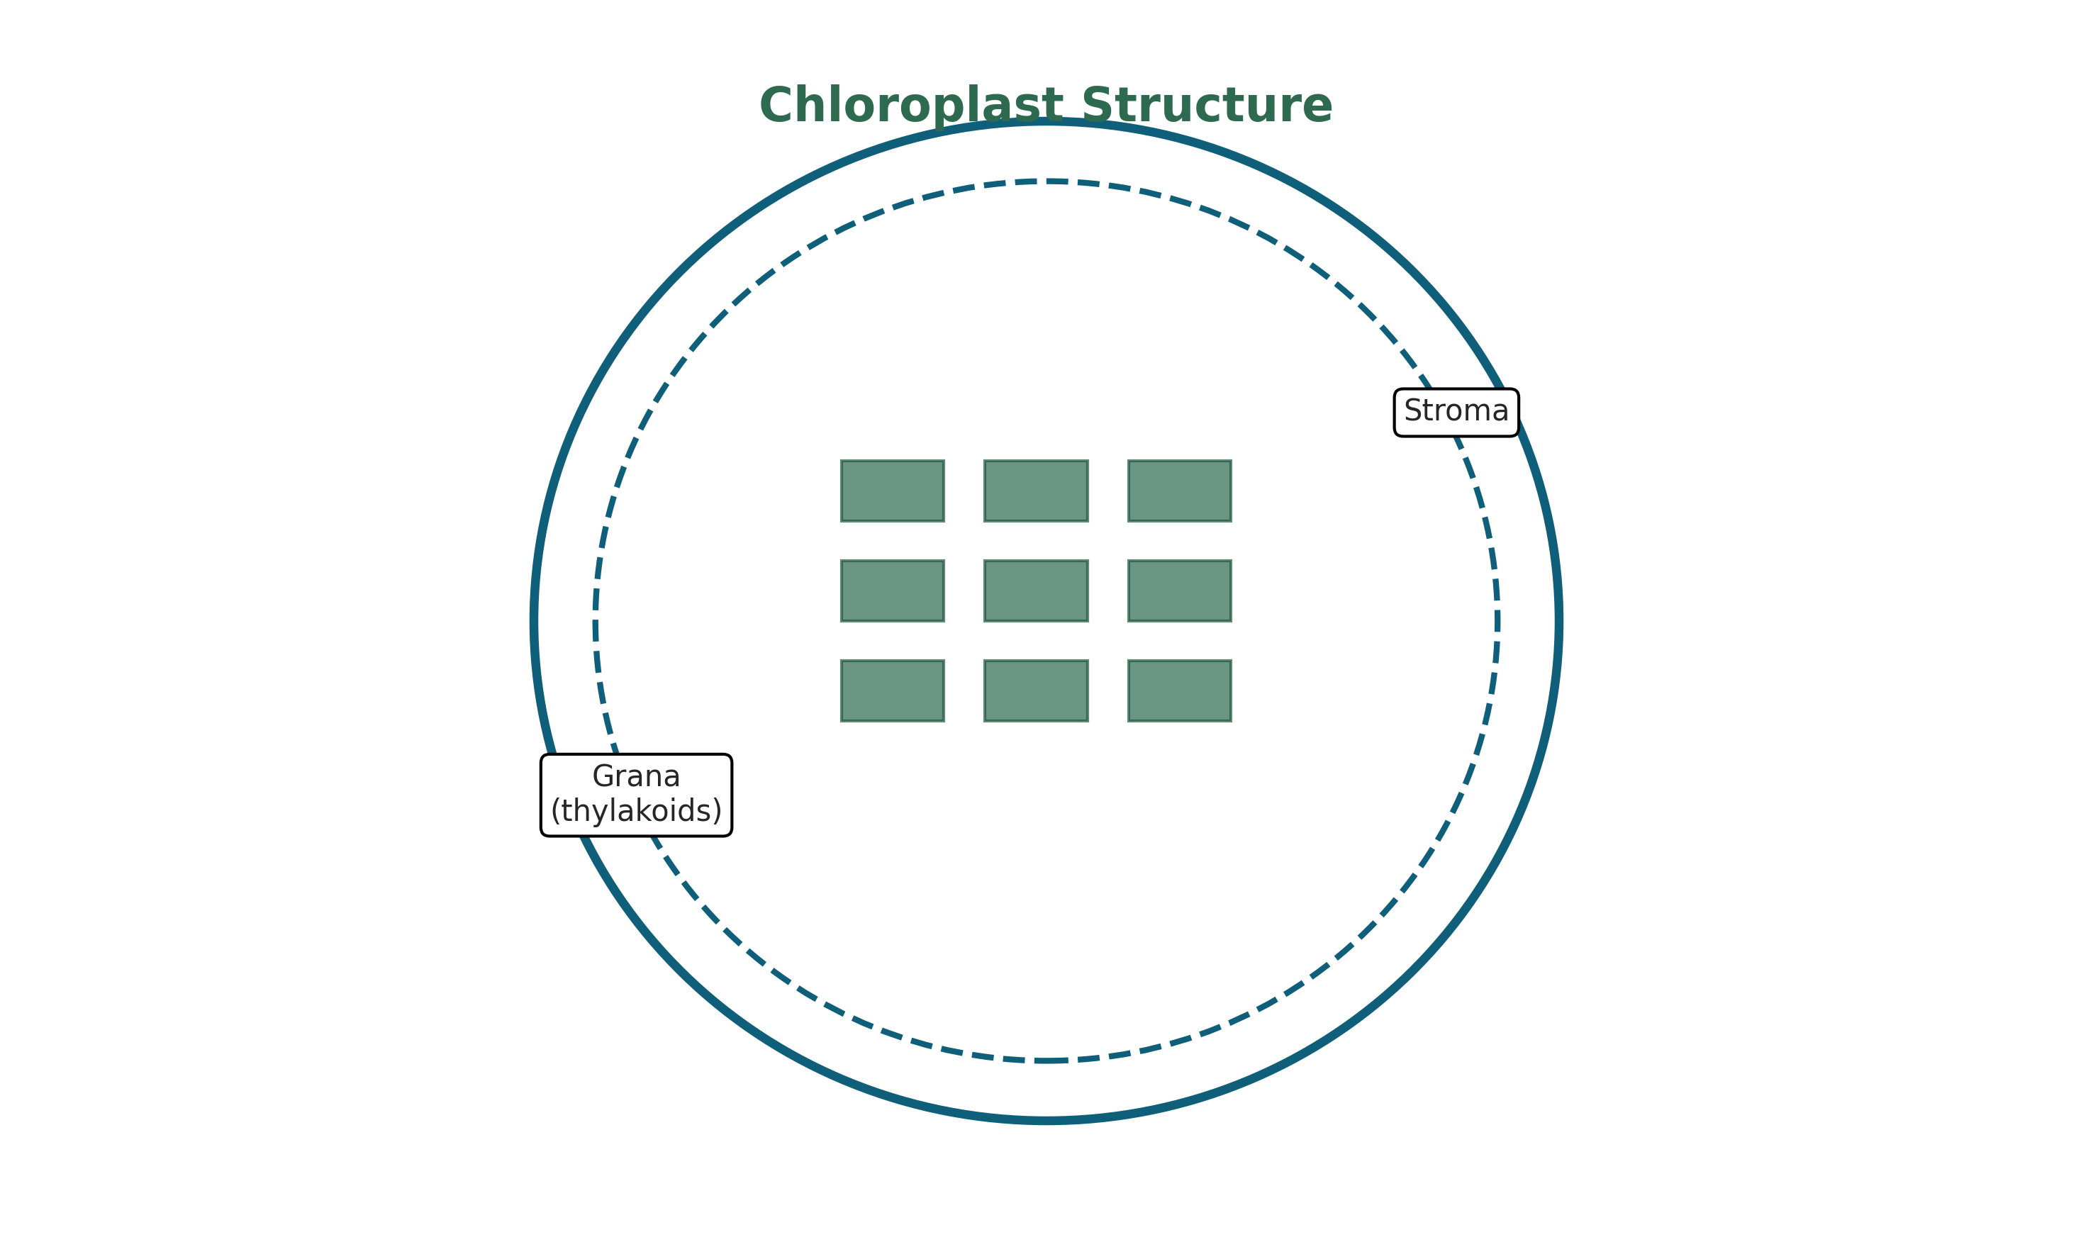
Chloroplast Structure
Outer membrane
Inner membrane
STROMA
• Fluid-filled matrix
• Calvin cycle occurs here
• Contains DNA, ribosomes
THYLAKOIDS
• Flattened sacs
• Membranes contain pigments & ETC
• Grana = stacks of thylakoids │
• Lumen = inside space
📌 Light reactions occur in thylakoid membranes ║
📌 Calvin cycle occurs in stroma

